Slide 1

CISC 250 – Business Telecomm Networks
ARP
&
Lab 3

Slide 2
Lab 3 Part I
Ethernet Frames
http://gaia.cs.umass.edu/wireshark-labs/HTTP-wireshark-file3.html

Slide 3
ARP: Address Resolution Protocol
Question: how to determine
MAC address of B
knowing B’s IP address?
Each IP node (Host, Router) on LAN has ARP table
ARP Table: IP/MAC address mappings for some LAN nodes
< IP address; MAC address; TTL>
TTL (Time To Live): time after which address mapping will be forgotten (typically 20 min)
137.196.7.78
1A-2F-BB-76-09-AD
137.196.7.23
137.196.7.14
LAN
71-65-F7-2B-08-53
58-23-D7-FA-20-B0
0C-C4-11-6F-E3-98
http://www.youtube.com/watch?v=p1zKRU7WMOE
137.196.7.88

Slide 4
ARP protocol: Same LAN
A wants to send datagram to B, but B’s MAC address is not in A’s ARP table.
A broadcasts ARP query frame, containing B's IP address
Dest MAC address = FF-FF-FF-FF-FF-FF
all machines on LAN receive ARP query
B receives ARP frame, replies to A with its (B's) MAC address
frame sent to A’s MAC address (unicast)
A caches (saves) IP-to-MAC address pair in its ARP table until information becomes old (times out)
soft state: information that times out (goes away) unless refreshed
ARP is “plug-and-play”:
nodes create their ARP tables without intervention from net administrator

Slide 5
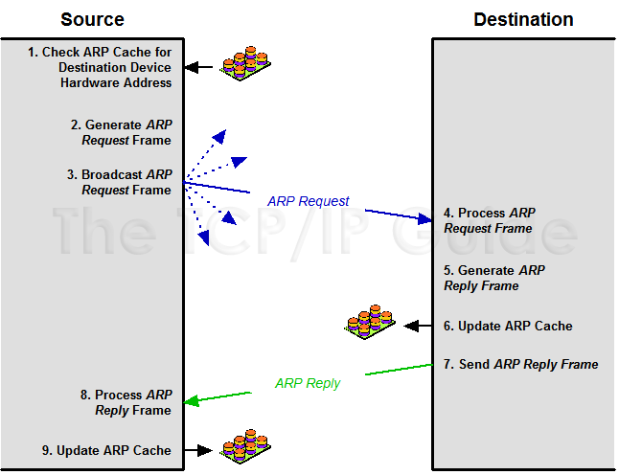
ARP protocol: Same LAN

Slide 6
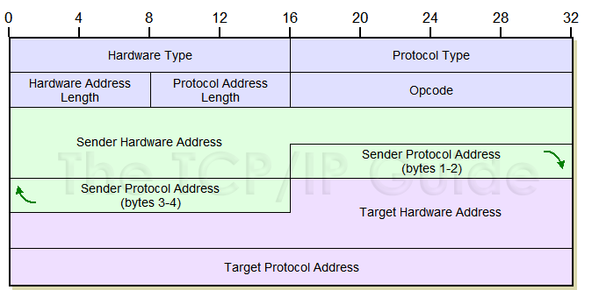
ARP message format

Slide 7
Lab 3 Part II
ARP protocol
http://gaia.cs.umass.edu/wireshark-labs/HTTP-wireshark-file3.html

Slide 8

ARP SPOOFING!! How does it work?
Switch forwarding traffic based on MAC address
Target 1
IP: 192.168.1.1
Hw: 00:00:00:00:00:01
Target 2
IP: 192.168.1.100
Hw: 00:00:00:00:00:02
Switch
ARP is a stateless protocol. Network hosts will automatically cache any ARP replies they receive, regardless of whether or not they requested them.
AM (Attacking Machine)
IP: 192.168.1.121
Hw: 00:00:00:00:00:03
Before Attack……..

Slide 9
Before attack, T1 and T2 are talking to each other only. Below is the arp table of the machines.
T1(192.168.1.1):
T2(192.168.1.100):
192.168.1.100 | 00:00:00:00:00:02
192.168.1.123 | 00:00:00:00:00:14
192.168.1.1 | 00:00:00:00:00:01
192.168.1.123 | 00:00:00:00:00:14
The switch understands only MAC addresses and forwards the packets to the right machines based on this MAC address. What if we manipulate the arp tables (this is called arp poisoning) on T1 and T2 so that the target MAC address in all the packets being exchanged between them, becomes the MAC address of our attacking machine. You got it right. Then switch will forward the packet to the attacking machine.
So after attack arp table should look like something below:
T1:
T2:
192.168.1.100 | 00:00:00:00:00:03
192.168.1.123 | 00:00:00:00:00:14
192.168.1.1 | 00:00:00:00:00:03
192.168.1.123 | 00:00:00:00:00:14
Where 00:00:00:00:00:03 is the MAC address of attacking machine.

Slide 10
ARP SPOOFING!! How does it work?
Switch forwarding traffic based on MAC address
Target 1
IP: 192.168.1.1
Hw: 00:00:00:00:00:01
Target 2
IP: 192.168.1.100
Hw: 00:00:00:00:00:02
Switch
AM (Attacking Machine)
IP: 192.168.1.121
Hw: 00:00:00:00:00:03
After Attack……..

